Slide 1
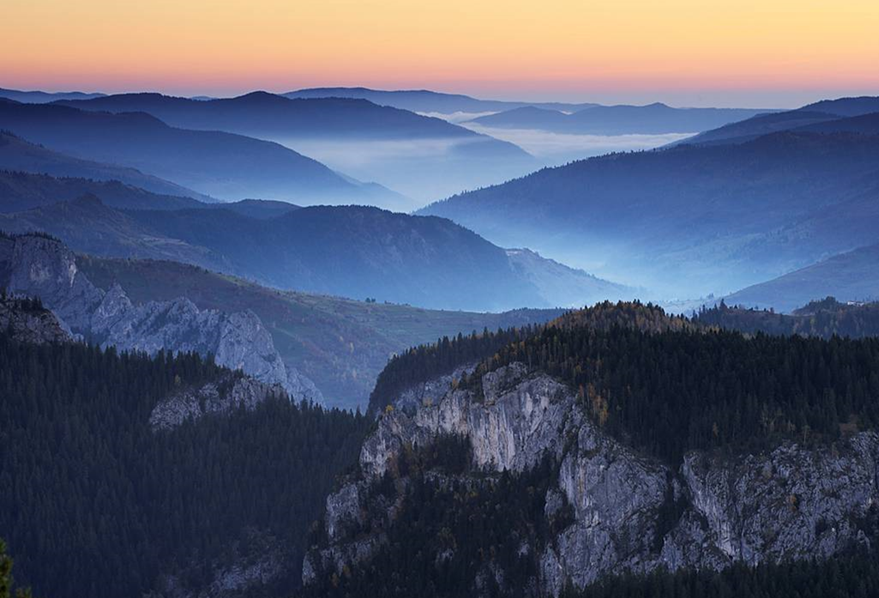

EU Danube Strategy: The environmental dimension
Andreas Beckmann, WWF Danube-Carpathian Programme
25 November 2013
Macro-Regional Strategies: Development and Prospects
© Cat Holloway / WWF-Canon

Slide 2
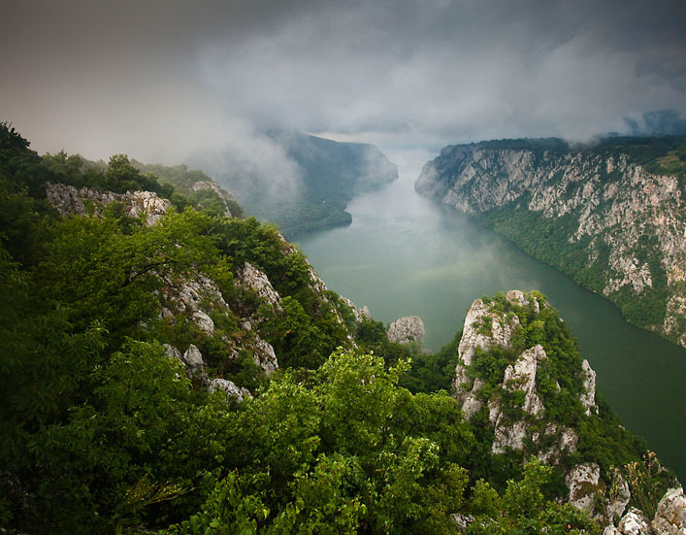
© Wild Wonders of Europe / Ruben Smit / WWF
Notes:
2

Slide 3
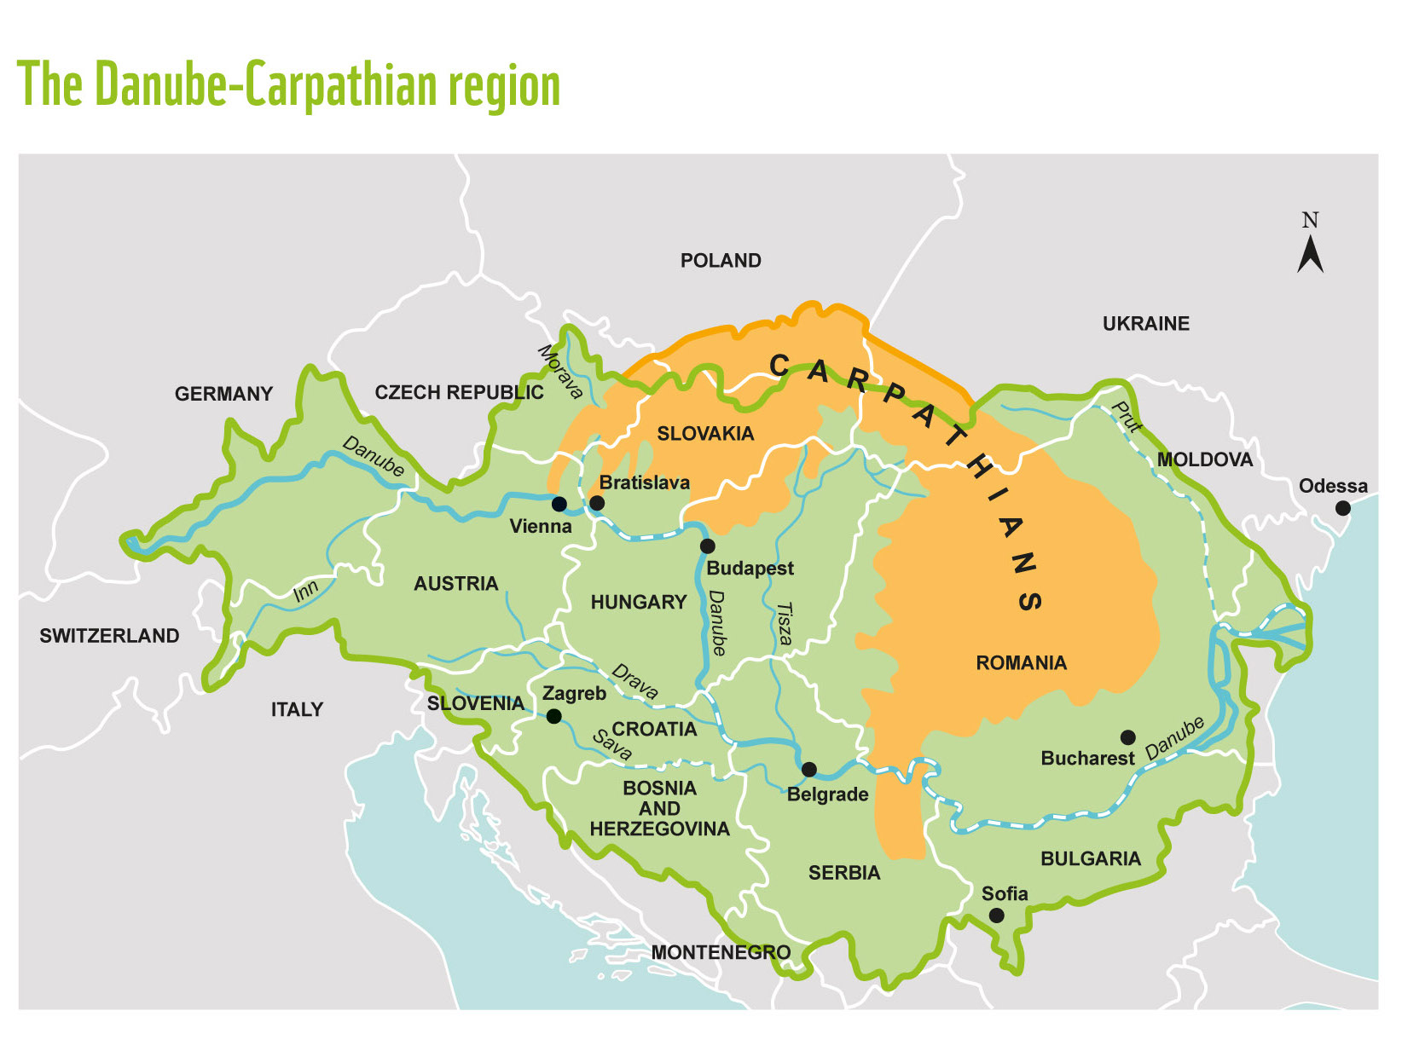
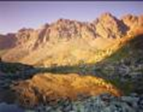
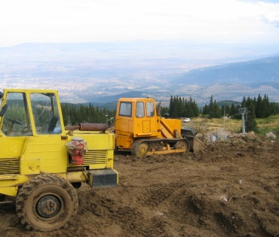
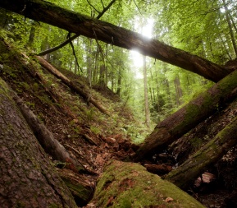
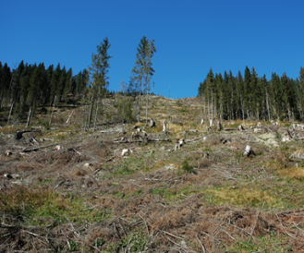

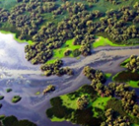
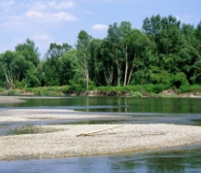
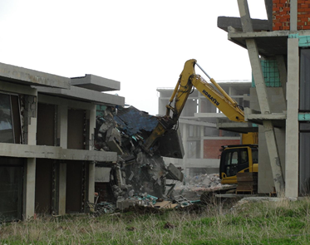
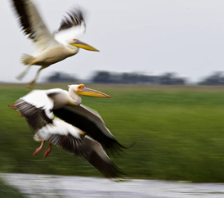

Slide 4
Key value of EUSDR:
Integration

Slide 5
Where are we going?

Slide 6
EU objectives
Climate: limit temperature increase to 2 degrees C
Carbon: 80% cut in emissions by 2050
Biodiversity: achieve favorable conservation status
Water: good status by 2015
Economy: sustainable, resource efficient by 2050
2020 Strategy for Growth: employment, R&D, GHG emissions, education, poverty/social exclusion.
Notes:
80% cut in emissions by 2050: EU Roadmap for moving to a low-carbon economy
2020 Strategy for Growth:
1. ensuring 75 % employment of 20–64-year-olds;
2. getting 3 % of the EU’s GDP invested into research and development;
3. limiting greenhouse gas emissions by 20 % or even 30 % compared to 1990 levels, creating 20 % of our
energy needs from renewables and increasing our energy efficiency by 20 %;
4. reducing school dropout rates to below 10 %, with at least 40 % of 30–34-year-olds completing tertiary education;
5. ensuring 20 million fewer people are at risk of poverty or social exclusion.

Slide 7
EUSDR objectives
Based on a current view, not a future vision.
Notes:
80% cut in emissions by 2050: EU Roadmap for moving to a low-carbon economy
2020 Strategy for Growth:
1. ensuring 75 % employment of 20–64-year-olds;
2. getting 3 % of the EU’s GDP invested into research and development;
3. limiting greenhouse gas emissions by 20 % or even 30 % compared to 1990 levels, creating 20 % of our
energy needs from renewables and increasing our energy efficiency by 20 %;
4. reducing school dropout rates to below 10 %, with at least 40 % of 30–34-year-olds completing tertiary education;
5. ensuring 20 million fewer people are at risk of poverty or social exclusion.

Slide 8
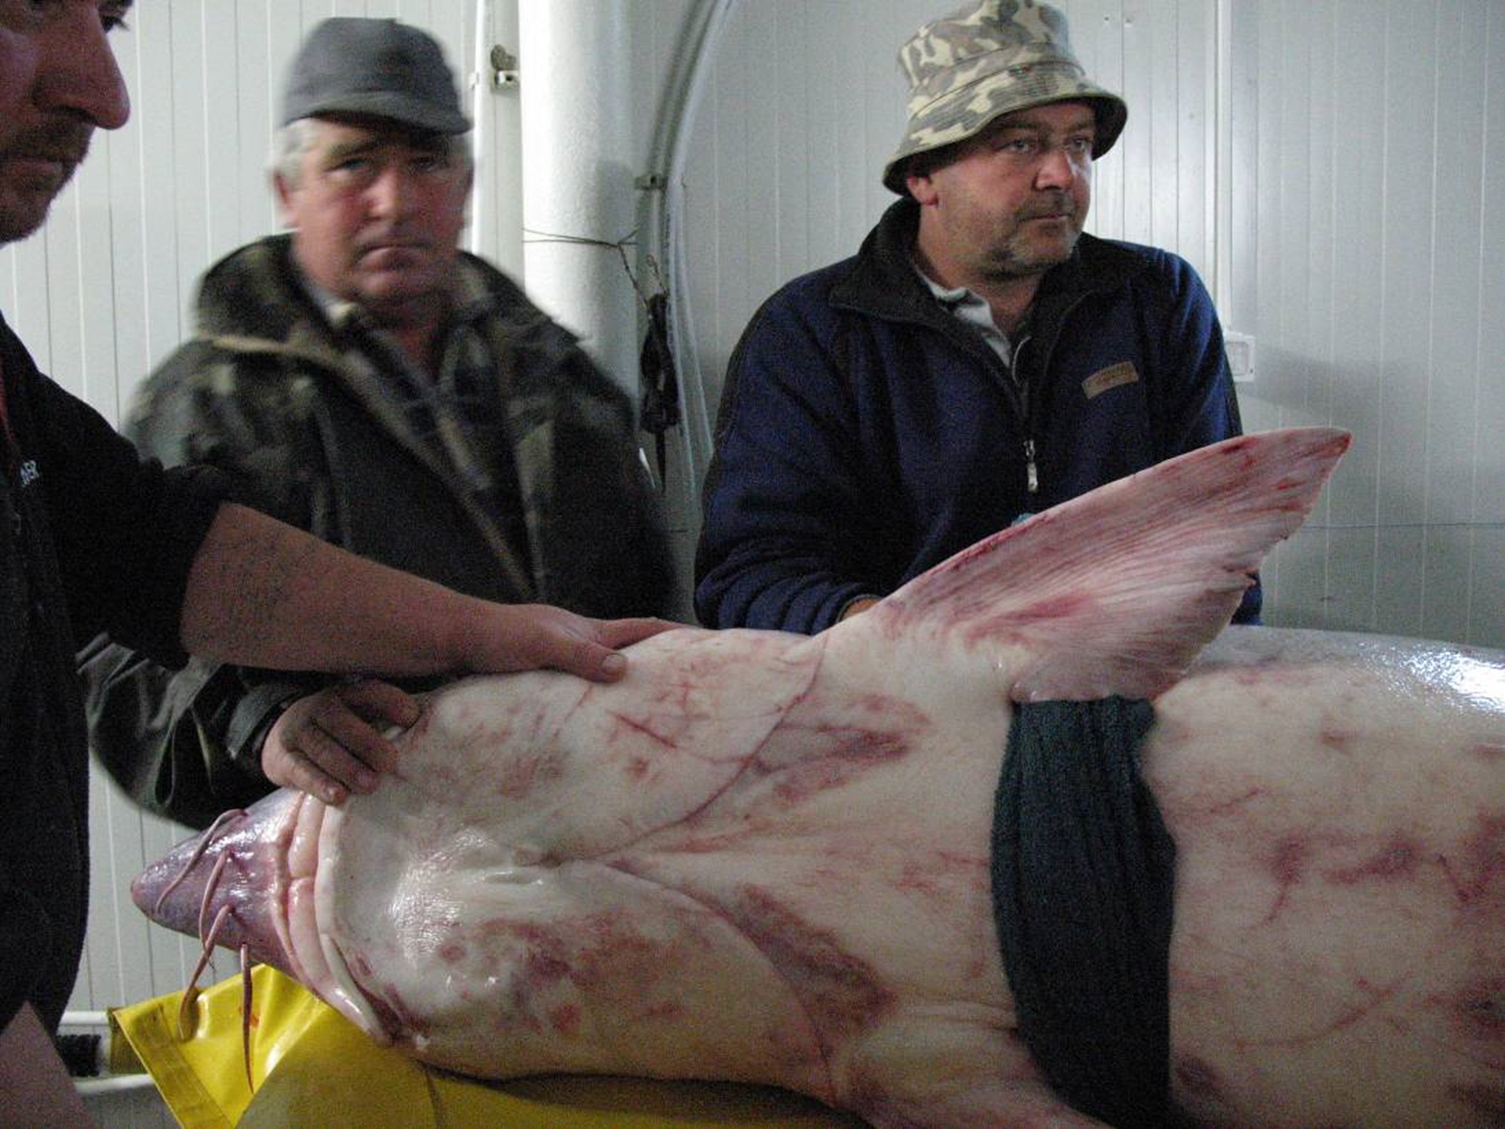
Danube sturgeon
© Edward Parker / WWF-Canon

Slide 9
Danube sturgeon
Integrated approach led by PAC6
Involves virtually all PA’s – biodiversity, navigation, water management, risk, law enforcement
Draws on expertise of IAD, WWF

Slide 10
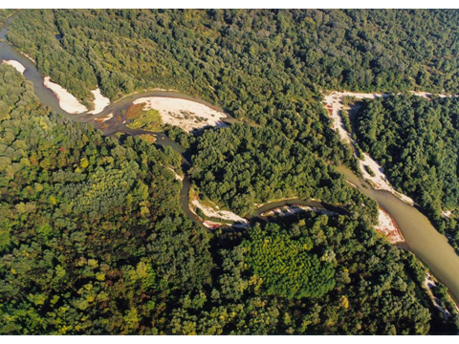
Floodplains
© Edward Parker / WWF-Canon

Slide 11
Floodplain protection, restoration
Major priority for Danube governments
Great potential
Priority for PA6, PA5
But much more could be done…

Slide 12
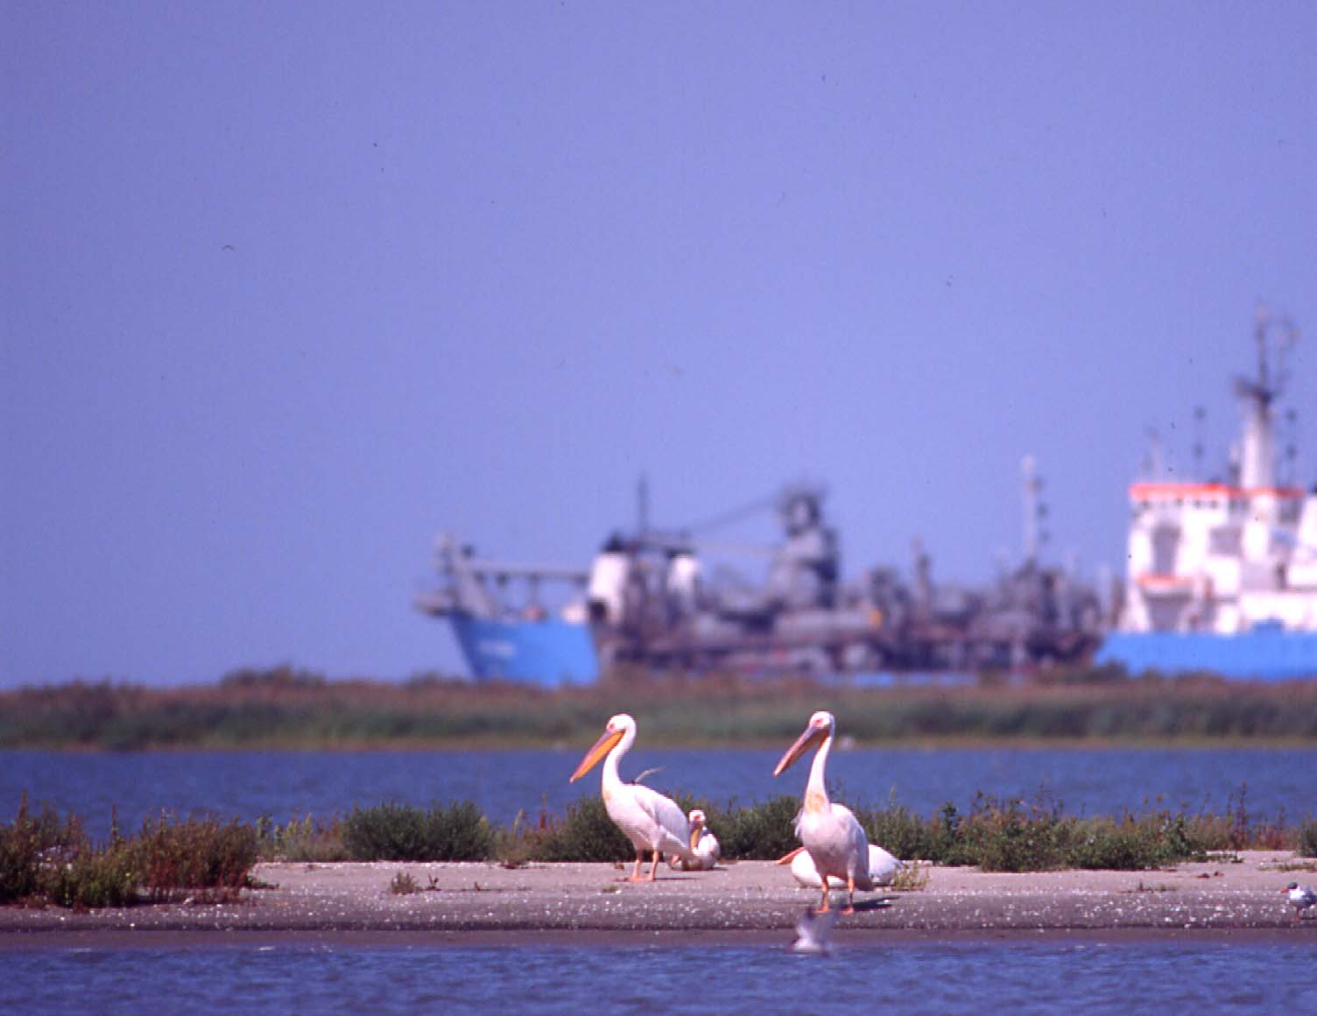
Inland navigation
© Edward Parker / WWF-Canon

Slide 13
Inland navigation
Good integrated approach by PAC1a
Very positive cooperation with PA6 (Biodiversity)
Could be more active e.g. on Sava River
Some questionable projects, e.g. Bucuresti canal
Positive involvement of EC
Need for technical facility to advise projects

Slide 14
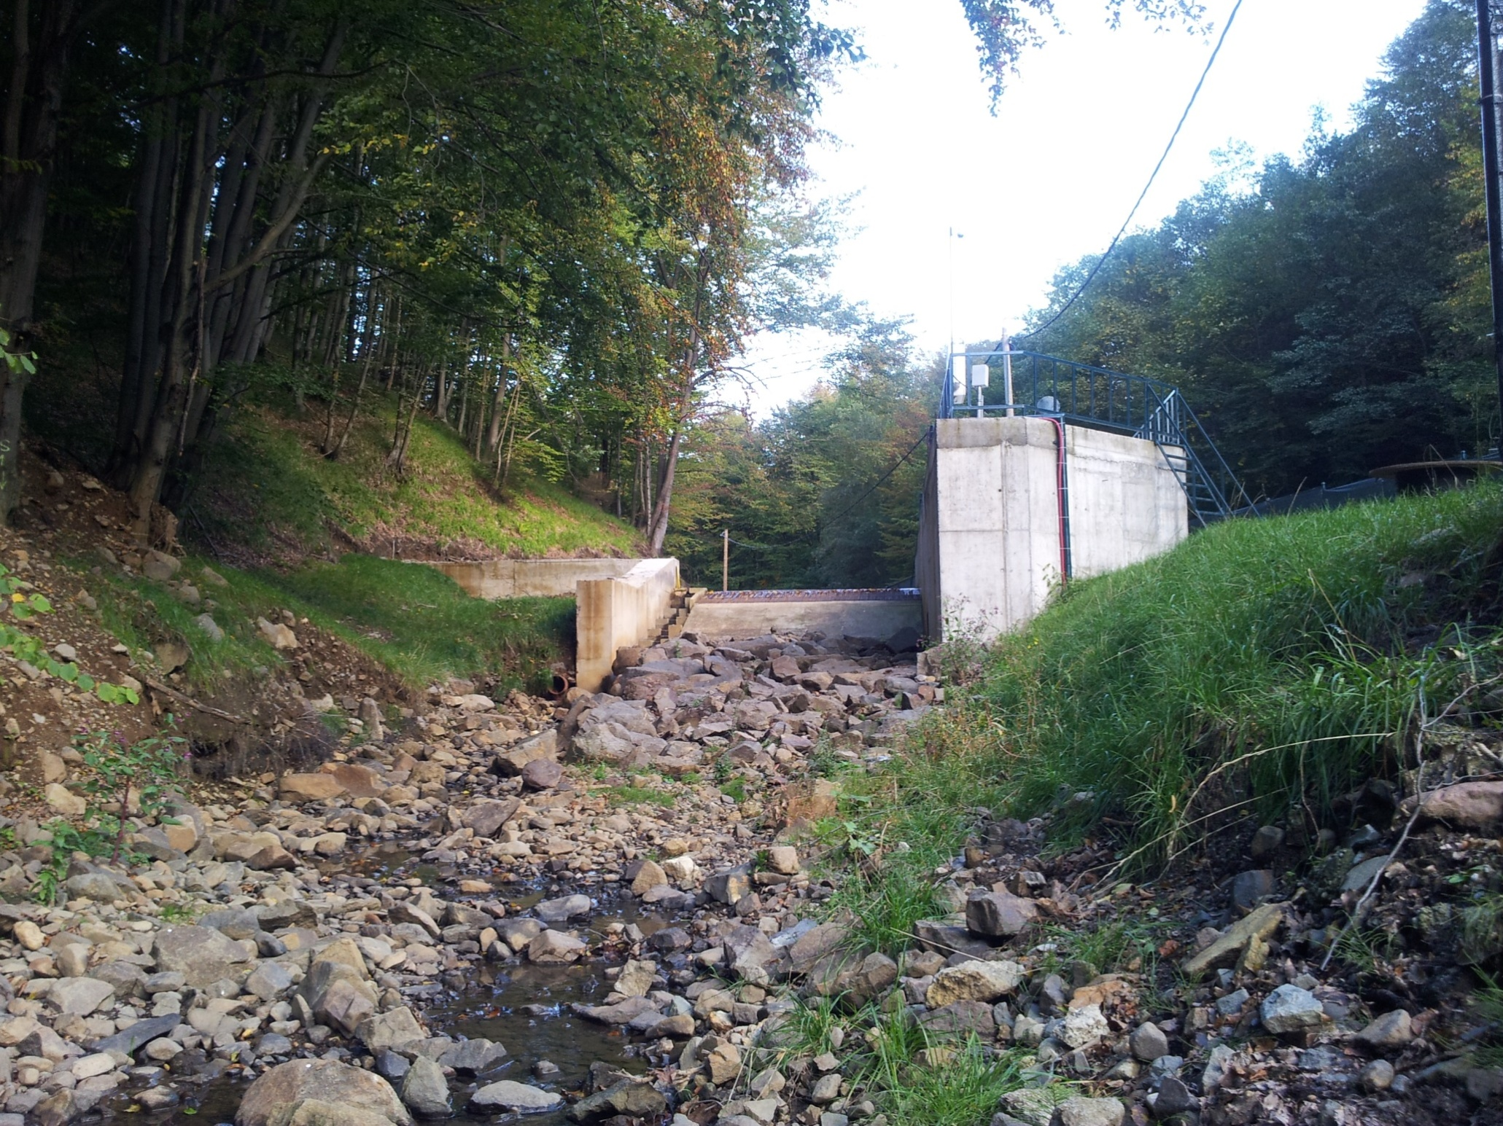
Hydropower
Integration?
© Edward Parker / WWF-Canon

Slide 15
Priority Areas
Sectoral focus, limited integration
Missing: agriculture, forests
PA6 Biodiversity: unique, needed and valuable
PA4 Water management: added value vs ICPDR?
PA2 Energy: integration?

Slide 16
Stakeholder involvement
Communities and civil society have a valuable contribution to make to the EUSDR – but that contribution is not being fully realised.

Slide 17
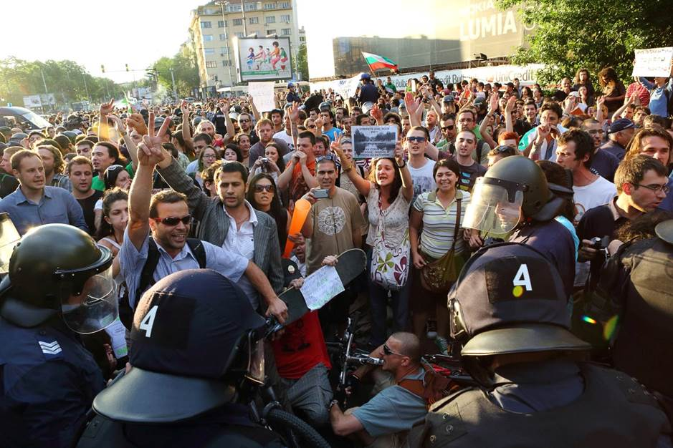
© WWF
Demonstration for forests
Eagle‘s bridge, Sofia, 2012

Slide 18
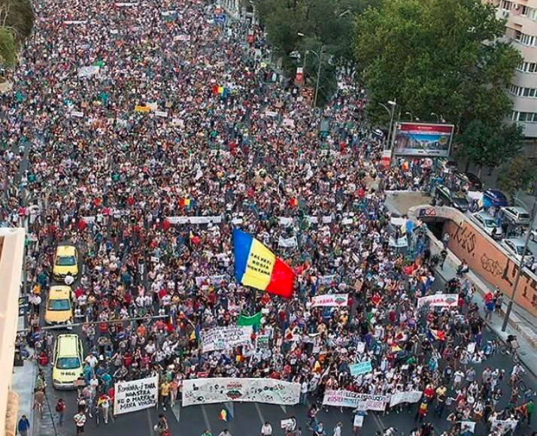
For Rosia Montana Bucharest, 2013
© WWF

Slide 19
Recommendations
Get serious about the EUSDR
Get serious about integration
Focus on the end objective, not current reality
Involve and work with local communities, NGOs

Slide 20
Summary
EUSDR is a journey.
We have started and have made some positive steps, but have much to improve, and much more to do.
Let‘s move forward.

Slide 21
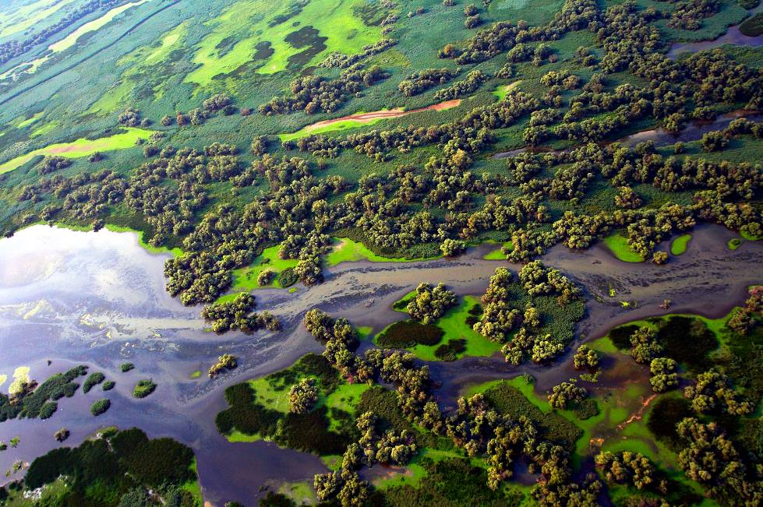
© Mario Romulic
Thank you for your attention
www.panda.org/dcpo
Notes:
21

